Slide 1

CLASSIFICATION OF SIGNIFICANT WATER RESOURCES AND DETERMINATION OF RESOURCE QUALITY OBJECTIVES FOR WATER RESOURCES IN THE USUTU TO MHLATHUZE CATCHMENTS (WP11387)
Project Steering Committee 1, Virtual: 7 June 2022

Slide 2
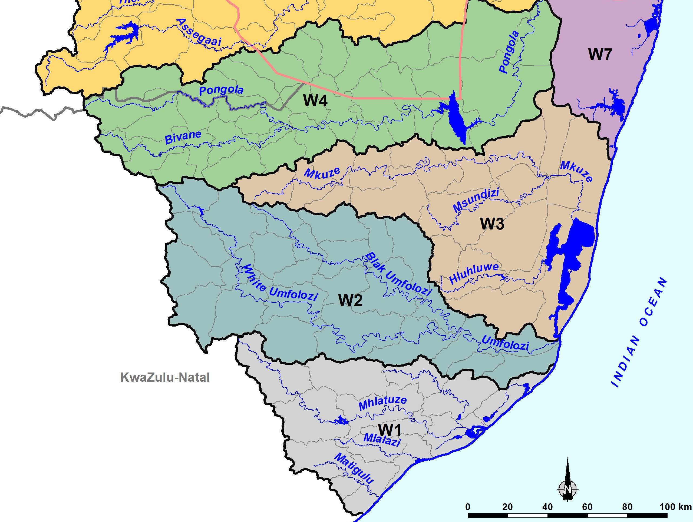
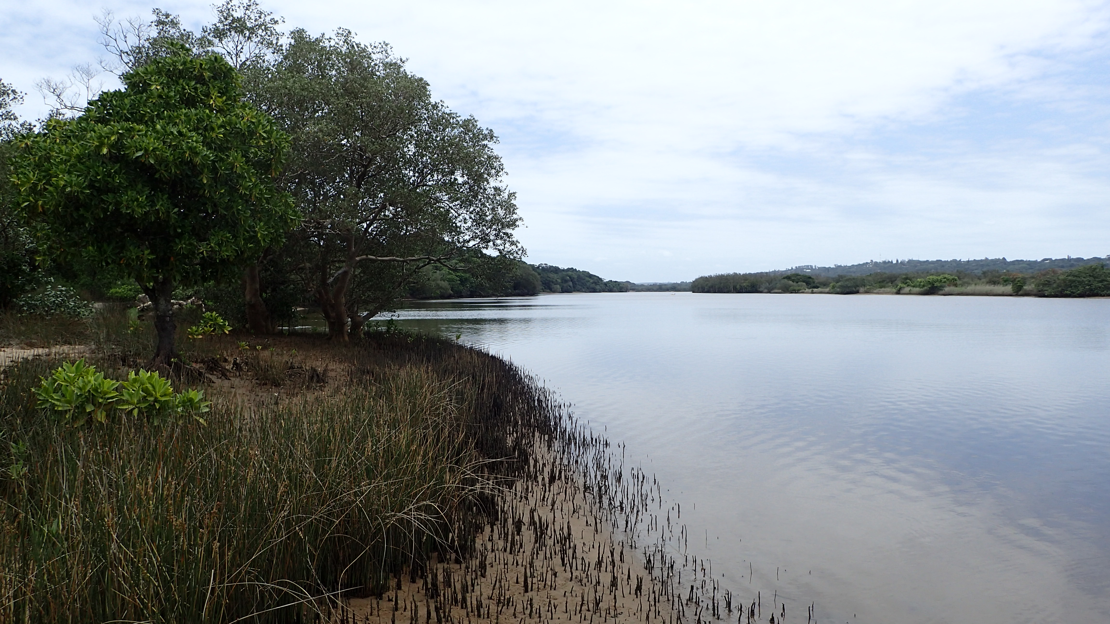
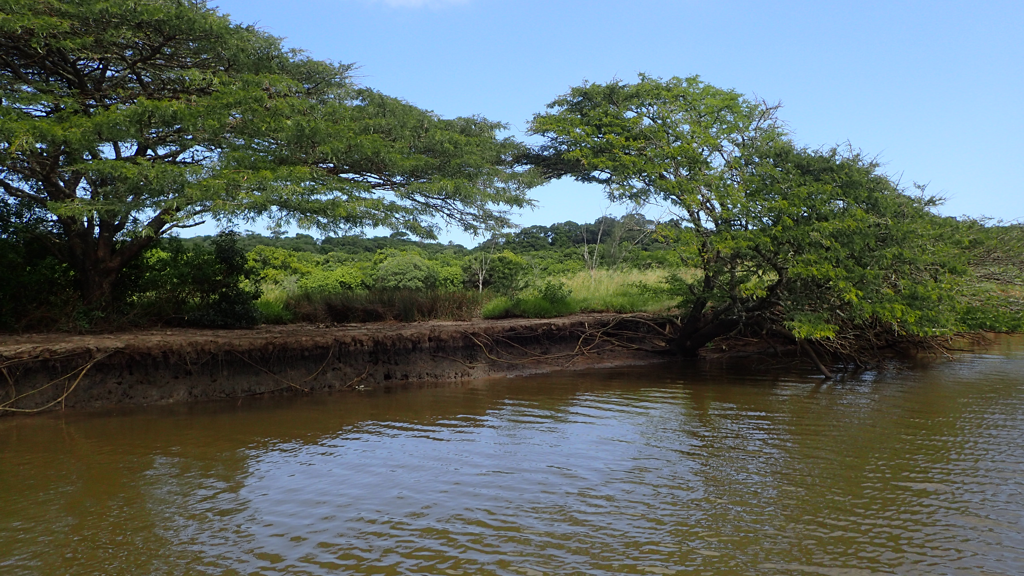
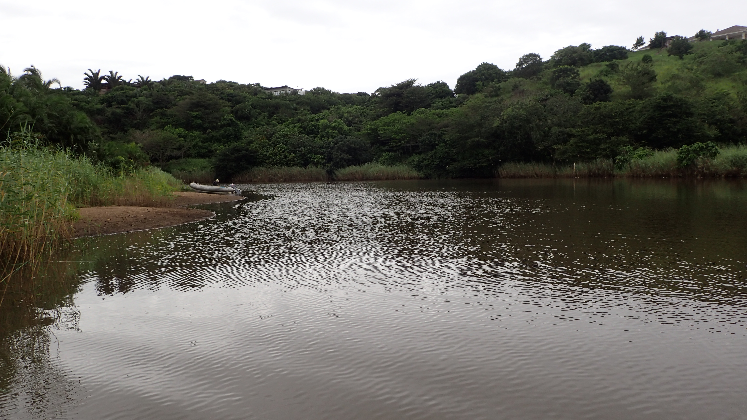
STUDY AREA
Estuarine Lake
Estuarine Lake
Estuarine Lake
Large Fluvially
Dominated
Estuarine Lake ➔ Small Predominantly Closed
Estuarine Lake ➔ Predominantly Open + Estuarine Bay
Predominantly Open
Small Predominantly Closed
Predominantly Open
Notes:
This is just brief, the details will come in 4.3

Slide 3
STATUS QUO: Estuary Condition & Pressures
 | Estuary Name | PES | Pressure*
 |  |  | Cumulative | Flow | Pollution | Habitat loss | Fishing Effort | Invasive alien plants | Alien Fish | Artificial Breaching
W11 | aMatigulu/ iNyoni | B | L | L | L | L | H |  |  | L
W13 | iSiyaya | E | VH | VH | VH | VH | M
W13 | uMlalazi | B | L | M | L | M | H | M | H | L
W12 | uMhlathuze | D | H | L | VH | VH | VH |  | H
W12 | Richards Bay | D/E | H | H | H | VH | VH
W12 | iNhlabane | E | VH | M | H | VH | H
W2 | iMfolozi /uMsunduze | D | H | L | VH | VH | VH | H |  | H
W3 | St Lucia | D/E | H | L | M | M | VH | M |  | VH
W7 | uMgobezeleni | B | L | L | L | L | H |  |  | M
W7 | Kosi | A/B | L | L | L | L | VH | L
*VH=Very high, H=High, M=Medium, L=Low
Notes:
Caryn to do the scope, will be Tasks of study, deliverables, reference to previous ewr study, use some of following slides, but simplify

Slide 4
Estuary Condition Summary
Nine estuaries occur in the study areas, with the uMhlathuze estuarine lake system subdivided to create an estuarine bay (Richards Bay) and a Predominantly open system (uMhlathuze Sanctuary) to accommodate a port development in the 1970s.
Most of the systems in the study area in a degraded state (D to E), under high to very high pollution, habitat loss and fishing pressure.
Most estuaries are not under high flow modification pressure with the exception of iSiyaya and Richards Bay.
Only four estuaries in a near-natural state (A/B to B), - aMatigulu/iNyoni, uMlalazi, uMgobezeleni and Kosi.
Notes:
Caryn to do the scope, will be Tasks of study, deliverables, reference to previous ewr study, use some of following slides, but simplify

Slide 5
ESTUARY Ecological IMPORTANCE
# | Estuary | Size | Habitat diversity | Zonal type rarity | Biodi-versity | Score | Importance | Biodiversity Importance Rating
W11 | aMatigulu/ iNyoni | 90 | 70 | 30 | 89 | 79 | Important | 4
W13 | iSiyaya | 30 | 60 | 10 | 47 | 40 | Ave Importance | 3
W13 | uMlalazi | 90 | 90 | 30 | 95.5 | 85 | Very Important | 5
W12 | uMhlathuze | 100 | 100 | 80 | 53.5 | 86 | Very Important | 5
W12 | Richards Bay | 100 | 0 | 80 | 85 | 69 | Important | 4
W12 | iNhlabane | 50 | 50 | 70 | 86 | 61 | Important | 4
W2 | iMfolozi/ uMsunduze | 90 | 100 | 70 | 93.5 | 91 | Very Important | 5
W3 | St Lucia | 100 | 100 | 70 | 98.5 | 97 | Very Important | 5
W7 | uMgobezeleni | 10 | 80 | 70 | 37 | 40 | Ave Importance | 3
W7 | Kosi | 100 | 100 | 70 | 100 | 97 | Very Important | 5
Five of the estuaries are of very high ecological importance - uMlalazi, uMhlathuze, iMfolozi/uMsunduze St Lucia, and Kosi

Slide 6
Biodiversity/ CONSERVATION IMPORTANCE
# | Estuary | Protected Area | Ramsar site | Important Bird Area | Priority set for conservation | NBA Recommended extent of protection | NBA Minimum recommended % undeveloped margin | Provisional Recommended Ecological Category | Biodiversity Importance Rating
W11 | aMatigulu/iNyoni |  |  |  |  | Partial | 0.5 | A | 5
W13 | iSiyaya |  |  |  |  | Full | 0.5 | B | 5
W13 | uMlalazi |  |  |  |  | Full | 0.75 | A or BAS | 5
W12 | uMhlathuze |  |  |  |  | Partial | 0.5 | A or BAS | 5
W12 | Richards Bay |  |  |  |  | Partial | 0.5 | A or BAS | 5
W12 | iNhlabane |  |  |  |  | - | - | C | 1
W2 | iMfolozi/ uMsunduze |  |  |  |  | Full | 0.75 | A | 5
W3 | St Lucia |  |  |  |  | Full | 0.75 | A | 5
W7 | uMgobezeleni |  |  |  |  | Full | 0.75 | A or BAS | 5
W7 | Kosi |  |  |  |  | Full | 0.75 | A or BAS | 5
All estuaries, except iNhlabane, are conservation priorities being either in formally protected areas (i.e. provincial park, iSimangaliso Wetland Park and UNESCO World Heritage Site) or desired protected area. In addition, 3 systems are Ramsar sites and 5 systems Important Bird Areas

Slide 7
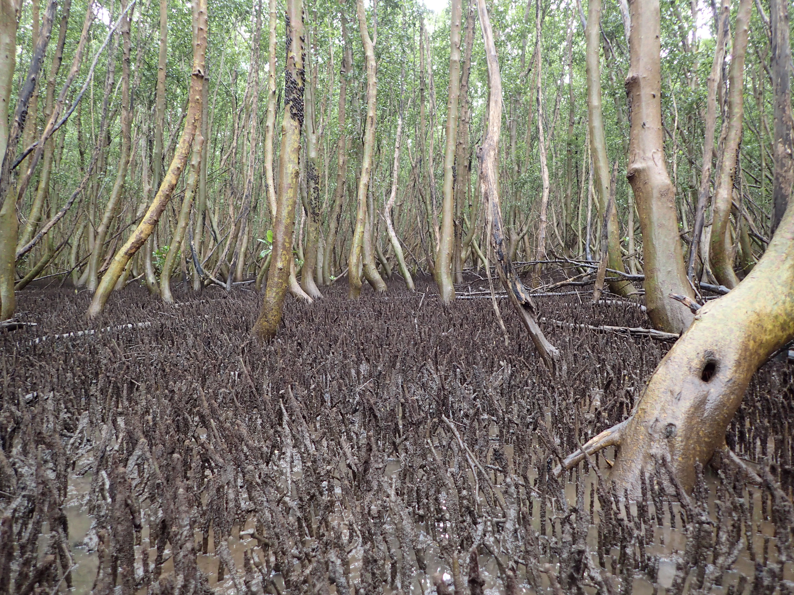
ECOSYSTEM SERVICES
# | Estuary | Carbon sequestration | Nursery Function | Ecosystem Services Rating
W11 | aMatigulu/iNyoni | Medium | High | 5
W13 | iSiyaya | Medium | Low | 3
W13 | uMlalazi | High | High | 5
W12 | uMhlathuze | High | High | 5
W12 | Richards Bay | High | High | 5
W12 | iNhlabane | High | Medium | 5
W2 | iMfolozi/uMsunduze | High | High | 5
W3 | St Lucia | High | High | 5
W7 | uMgobezeleni | Medium | Low | 3
W7 | Kosi | High | High | 5
Most of the systems highly important for provision of ecosystem services
Blue carbon sequestration: uMlalazi, uMhlathuze, Richards Bay, iNhlabane, iMfolozi/uMsunduze, St Lucia, and Kosi
Fish nursery function: aMatigulu/iNyoni, uMlalazi, uMhlathuze, Richards Bay, iMfolozi/uMsunduze, St Lucia, and Kosi

Slide 8
Integrated Environmental Importance
# | NAME | Present Ecological State | Ecological Importance | Biodiversity/Conservation Importance | Combined Ecological & Conservation Importance | Ecosystem Services Value | Max (EI, ES) | Integrated Environmental Importance (IEI)
W11 | aMatigulu/iNyoni | B | 4 | 5 | 5 | 5 | 5 | 5
W13 | iSiyaya | E | 3 | 5 | 5 | 3 | 5 | 3
W13 | uMlalazi | B | 5 | 5 | 5 | 5 | 5 | 5
W12 | uMhlathuze | D | 5 | 5 | 5 | 5 | 5 | 3
W12 | Richards Bay | D/E | 4 | 5 | 5 | 5 | 5 | 5
W12 | iNhlabane | E | 4 | 1 | 4 | 5 | 5 | 3
W2 | iMfolozi/uMsunduze | D | 5 | 5 | 5 | 5 | 5 | 3
W3 | St Lucia | D/E | 5 | 5 | 5 | 5 | 5 | 5
W7 | uMgobezeleni | B | 3 | 5 | 5 | 3 | 5 | 5
W7 | Kosi | A/B | 5 | 5 | 5 | 5 | 5 | 5
Six estuaries of very high Integrated Environmental Importance - aMatigulu/iNyoni, uMlalazi, Richards Bay, St Lucia, uMgobezeleni, Kosi.

